Slide 1

Sprocket Central Pty Ltd
Data analytics approach
[Division Name] - [Engagement Manager], [Senior Consultant], [Junior Consultant]

Slide 2
Agenda
Introduction
Data Exploration
Model Development
Interpretation

Slide 3
Introduction
customers analysis
Age distributions
Number of bike purchases in 3 years / percentages purchases
Job industry category.
Wealth segments
Number of cars own on each states
RFM Analysis
Recency vs Monetary analysis
Frequency vs Monetary analysis
Top 1000 customers based on their RFM Score

Slide 4
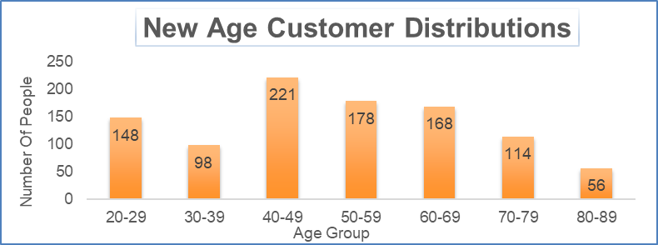
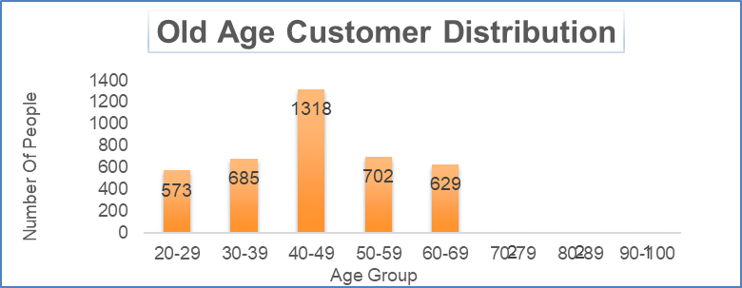
Data Exploration
new
Customers’ age distribution
As we can see, mostly our Old customers are between 25 to 48 years old.
Number of customers from 48 to 59 years old has big drops on percentages.
It looks like the percentages of under 25 years old not really change.
old

Slide 5
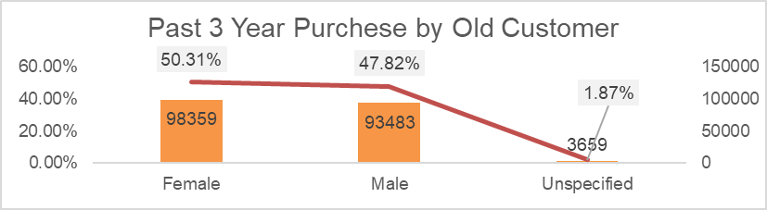
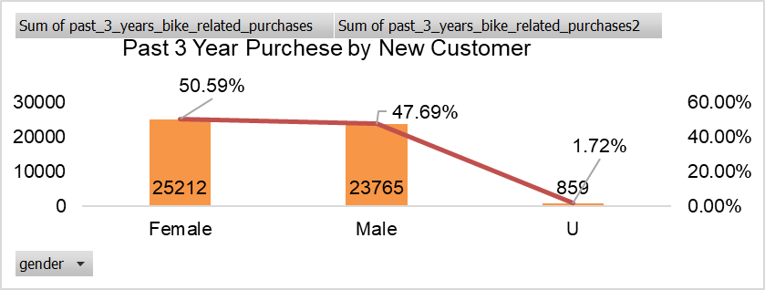
Data Exploration
Bike purchases last 3 years
As we can see, our new customers mostly Female with 50.6% purchases with total of 25,212 bikes
Male contributed to 47.7% purchases with 23,765 bikes
We can Also see that old customers mostly
female with 50.3% purchases with total of
98359 bikes
So we should focus on advertises on Female
customers than Male customers

Slide 6
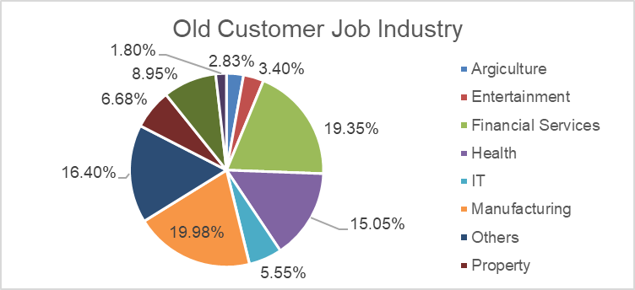
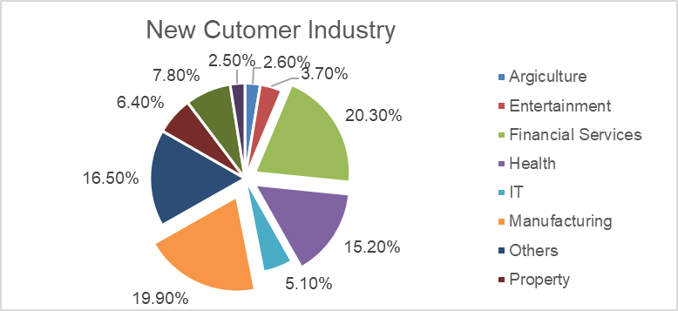
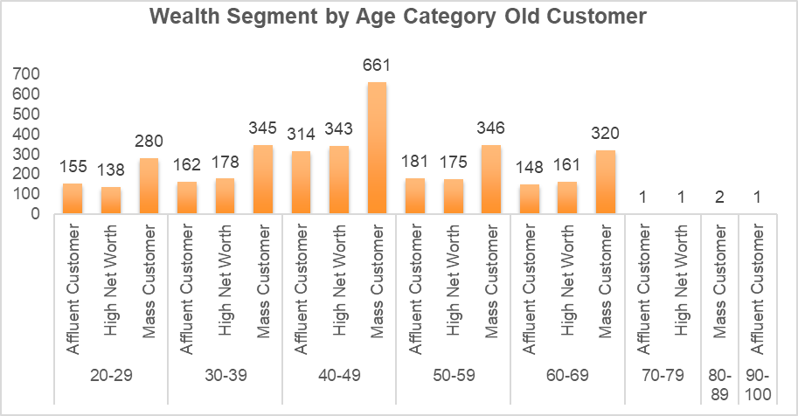
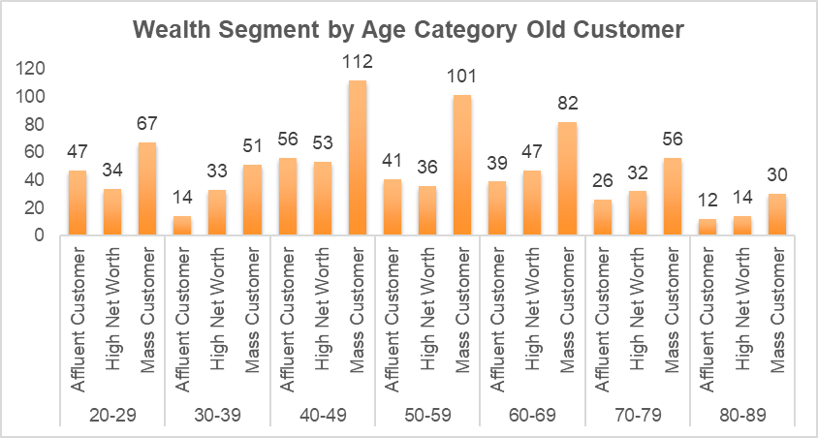
Data Exploration
Job industry category
Mostly our new customers are on Finance industry and our Manufacturing customers are still on top 2.
The rest industries is still same
Wealth segments
In all ages, the number of Mass Customers is the highest so we should focus on this social class.
After that, we should focus on High Net Customer.
Then Affluent Customers but mostly second and third quadrant

Slide 7
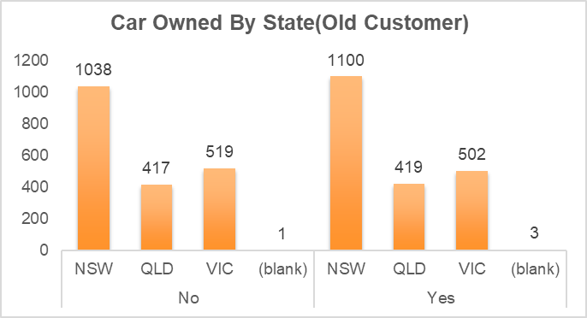
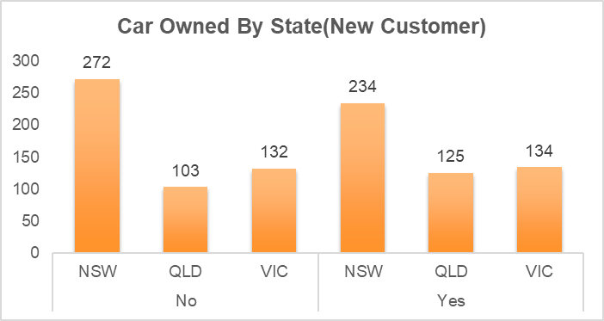
Data Exploration
Numbers of cars owned
NSW should be considered the most since numbers of customers don’t own cars is significantly larger than that own.
VIC and QLD has more customers that own car that who don’t but we can try to have something so that those owns car will buy bikes.

Slide 8
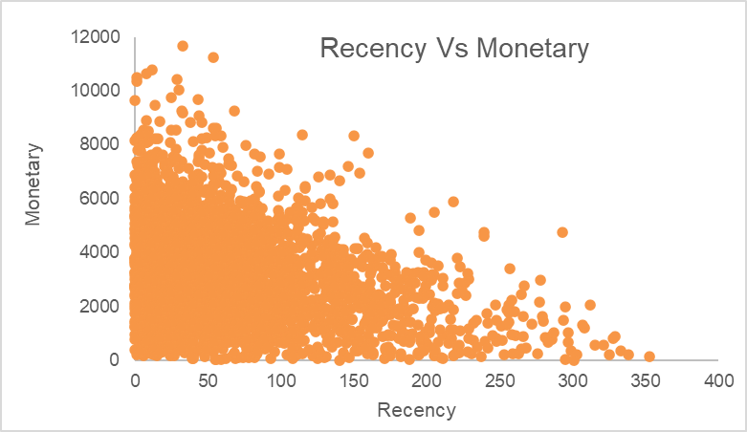
Data Exploration
RFM Analysis
The Charts Shows That Customers Who Purchased More Recently and frequently visit Have generated more revenue than customer who visited while ago
Customer From recent past 50-100 days also show to generate a moderate amount of revenue
Same case in Frequency

